Slide 1
Using Design Patterns

Slide 2
Introduction to Patterns
Each pattern describes a problem which occurs over and over again in our environment, and then describes the core of the solution to that problem, in such a way that you can use this solution a million times over.

Slide 3
Advantages of using Patterns
Promote reuse.
Use the experiences of software developers.
A shared library used by developers.
“Design patterns help a designer get a design right faster”.
Are based on the principles of object-oriented programming: abstraction, inheritance, polymorphism and association.
Are solutions to recurring problems to software design.

Slide 4
Which is Good Pattern?
  A good pattern should
    Be as general as possible
    Contain a solution that has been proven to effectively solve the problem in the indicated context.
  Studying patterns is an effective way to learn from the experience of others

Slide 5
Example:
Jim Coplein, a software engineer:
“I like to relate this definition to dress patterns…”
  What are dress patterns?
  “... I could tell you how to make a dress by specifying the route of
  a scissors through a piece of cloth in terms of angles and lengths of cut. Or, I could give you a pattern. Reading the specification, you would have no idea what was being built or if you had built the right thing when you were finished. The pattern foreshadows the product: it is the rule for making the thing, but it is also, in many respects,
  the thing itself.”

Slide 6
Patterns in engineering
How do other engineers find and use patterns?
  Mature engineering disciplines have handbooks
  describing successful solutions to known problems
  Automobile designers don't design cars from scratch
  using the laws of physics, Instead, they reuse standard designs with successful track records, learning from experience.

Slide 7
What is a Design Pattern?
A (Problem, Solution) pair.
A technique to repeat designer success.
Borrowed from Civil and Electrical Engineering domains.

Slide 8




How Patterns are used?
Designer
  Design Problem.
  Solution.
  Implementation details.
Programmer
Reduce gap
Design
Implementation
Gamma, E., Helm, R., Johnson, R., Vlissides, J.: Design patterns: elements of reusable object-oriented software. 1995.
Buschmann, F., Meunier, R., Rohnert, H., Sommerlad, P., Stal, M.: Pattern-oriented software architecture: a system of patterns. 2002.

Slide 9
Pattern description
  Context:
    The general situation in which the pattern applies
  Problem:
    A short sentence or two raising the main difficulty.
  Forces:
    The issues or concerns to consider when solving the problem
  Solution:
    The recommended way to solve the problem in the given context.
      ‘to balance the forces’

Slide 10
USEFUL DESIGN PATTERN
The most useful patterns that can be used in OO design and modeling using UML are as follows:
  The general hierarchy pattern
  The singleton pattern
  The façade pattern
  The factory pattern

Slide 11
The General Hierarchy Pattern
  Context:
    objects in a hierarchy can have one or more objects above them (superiors),
      and one or more objects below them (subordinates).
    Some objects cannot have any subordinates
  Problem:
    How do you represent a hierarchy of objects, in which some objects cannot have subordinates?

Slide 12
The General Hierarchy Pattern
  Forces:
    You want a flexible way of representing the hierarchy
      that prevents certain objects from having subordinates
    All the objects have many common properties and operations

Slide 13
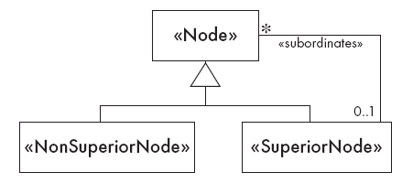
General Hierarchy
  Solution:

Slide 14
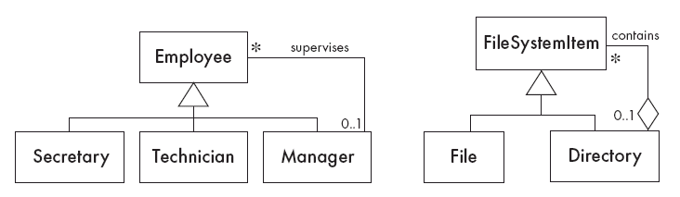
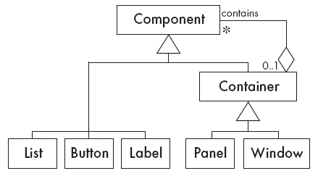
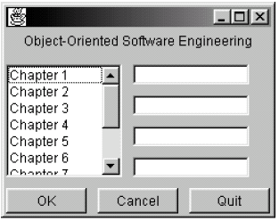
General Hierarchy
  Solution:

Slide 15
The Singleton Pattern
  Context:
    It is very common to find classes for which only one instance should exist (singleton)
  Problem:
    How do you ensure that it is never possible to create more than one instance of a singleton class?

Slide 16
The Singleton Pattern
  Forces:
    The use of a public constructor cannot guarantee that no more than one instance will be created.
    The singleton instance must also be accessible to all classes that require it

Slide 17
The Singleton Pattern
Sometimes it's important to have only one instance for a class. For example, in a system there should be only one window manager (or only a file system or only a print spooler). Usually singletons are used for centralized management of internal or external resources and they provide a global point of access to themselves.
The singleton pattern is one of the simplest design patterns: it involves only one class which is responsible to instantiate itself, to make sure it creates not more than one instance; in the same time it provides a global point of access to that instance. In this case the same instance can be used from everywhere, being impossible to invoke directly the constructor each time.

Slide 18
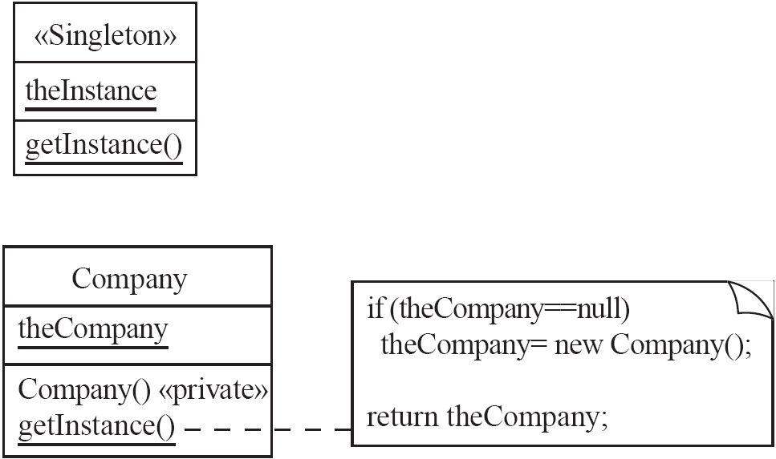
Singleton
  Solution:

Slide 19
The Façade Pattern
  Context:
    Often, an application contains several complex packages.
    A programmer working with such packages has to manipulate many different classes
  Problem:
    How do you simplify the view that programmers have of a complex package?

Slide 20
The Façade Pattern
  Forces:
    It is hard for a programmer to understand and use an entire subsystem
    If several different application classes call methods of the complex package, then any modifications made to the package will necessitate a complete review of all these classes.

Slide 21
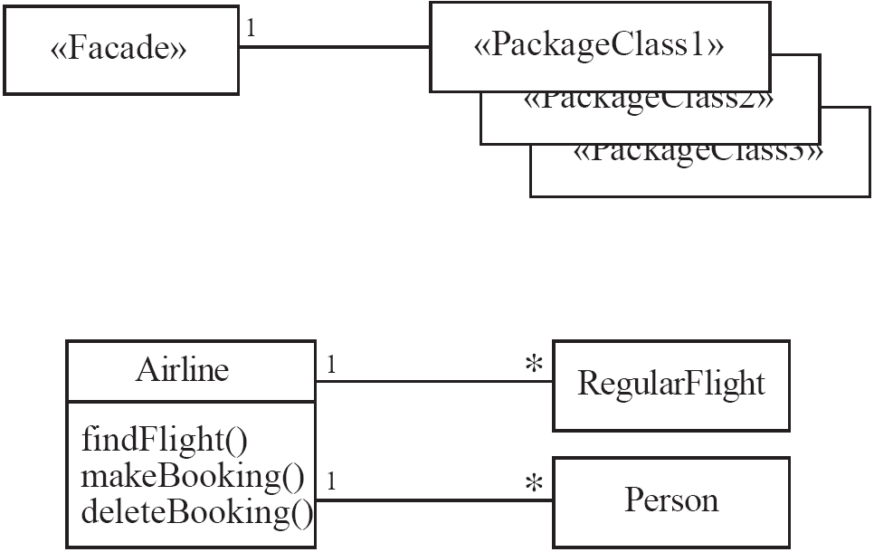
Façade
  Solution:

Slide 22
Example:
In the railway reservation and ticketing system, the most sought after requirements are put on façade class train, and the requirements changed most often are put on package class passenger, tourism company, enquiry clerk and announcer at the railway station.

Slide 23
Example:
Train
Find train no
Find train time
Make reservation
Make booking
Make cancellation
Passenger
Tourism company
Enquiry check
Announcer
Package
“Façade” Class

Slide 24
The Factory Pattern
  Context:
    A reusable framework needs to create objects; however the class of the created objects depends on the application.
  Problem:
    How do you enable a programmer to add new application-specific class into a system built on such a framework?

Slide 25
The Factory Pattern
  Forces:
    We want to have the framework create and work with application-specific classes that the framework does not yet know about.
  Solution:
    The framework delegates the creation of application-specific classes to a specialized class, the Factory.
    The Factory is a generic interface defined in the framework.
    The factory interface declares a method whose purpose is to create some subclass of a generic class.

Slide 26
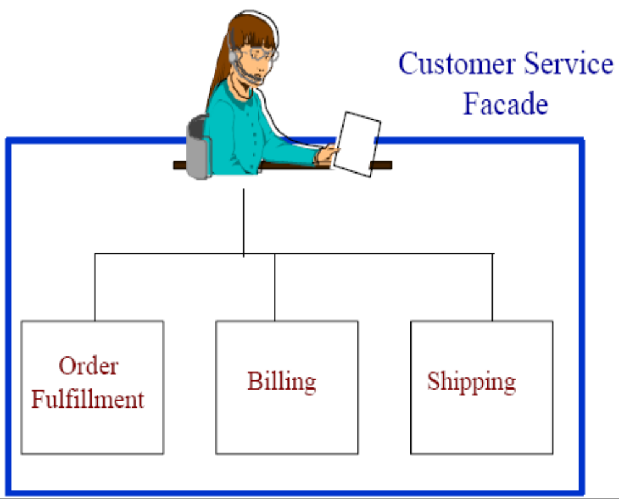
Facade (Non software example)
Provide a unified
interface to a set
of interfaces in a
subsystem.

Slide 27
Example:
Library application system may introduce different library items from time to time
e.g. originally issue/receipt of books only ; now offers magazines, novels, downloaded clippings from internet, CDs, DVDs and CD magazines etc
Adding a new library item should not result in making a change to the entire application.

Slide 28
Example:
Book
Magazines
CDs
Textbooks

Slide 29
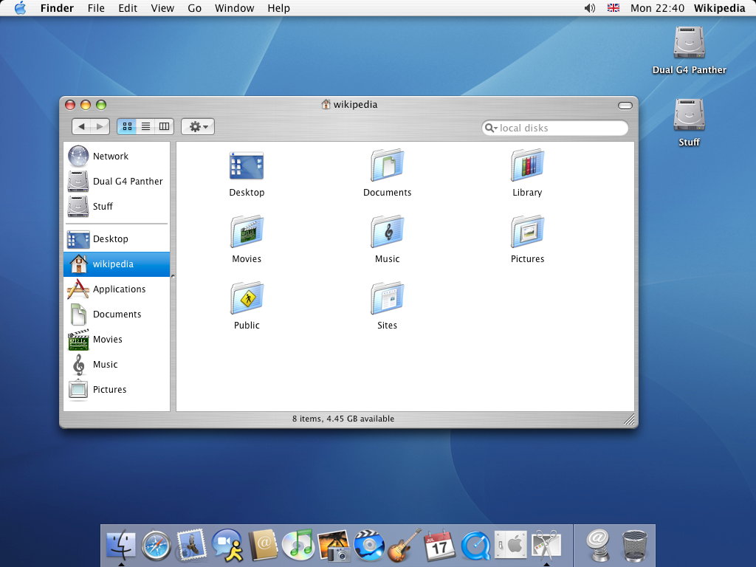

Facade (Software counterpart)

Slide 30
Benefits of Patterns
Design reuse
Uniform design vocabulary
Enhance understanding, restructuring, & team communication
Basis for automation
Transcends language-centric biases/myopia
Abstracts away from many unimportant details

Slide 31
Liabilities of Patterns
Require significant tedious & error-prone human effort to handcraft pattern implementations design reuse
Can be deceptively simple uniform design vocabulary
May limit design options
Leaves some important details unresolved

